Slide 1
Revenue Forecasting Case Study
Task
In this study, revenue and customer data is provided from two retail shops in 2022. The goal is to estimate the revenue and the new number of customers in those shops during 2023. Furthermore, The data is used to forecast the same metrics for two new shops which are planned to be launched during in March and July 2023.
Assumptions
Both shops were launched in 01.01.2022. Therefore, customer IDs that appear for the first time in the dataset are considered new customers
The growth rates in monthly revenue and new customers for both shops will continue into 2023 at the same rate as 2022
To simplify the analysis, we assume there are no boundaries for continuous growth (such as resources and shop capacity)
The planned new shops in 2023 will have both identical growth behavior to the regression average of shop 1 and 2 in 2022
For simplification, all data points will be included in regression calculations and no data points will be considered an outlier
Moataz Abdelmegid | 15.12.2023

Slide 2
Approach
The forecasting is performed arithmetically, where growth trends of revenue and customer numbers are tracked in 2022 and extrapolated to 2023
Regression will be based on monthly metrics (revenue and new customers) of the shop, regardless the number of orders in each month

Slide 3
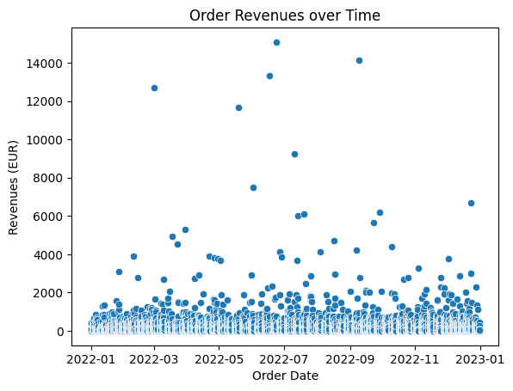
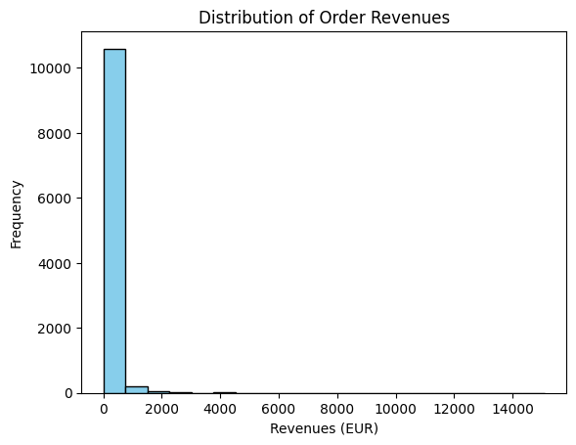
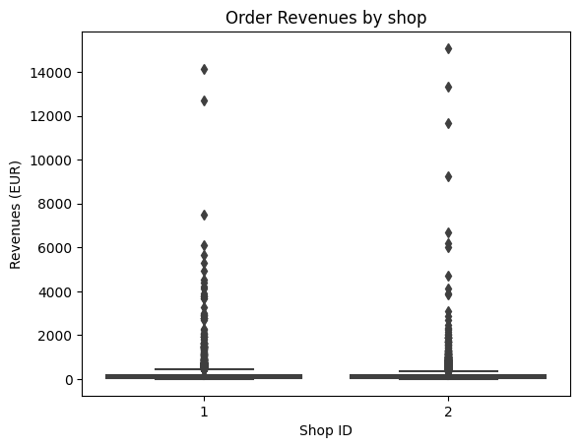
Exploratory Data Analysis (EDA)
The majority of orders are orders had less than 1000 EUR revenue
No observable temporal pattern for highly expensive orders
Both shops have outliers, and shop 2 has more high-value outliers, indicating that there are more revenue points that are significantly higher than the typical range
For simplicity, outliers will be included in the analysis as valid data points

Slide 4
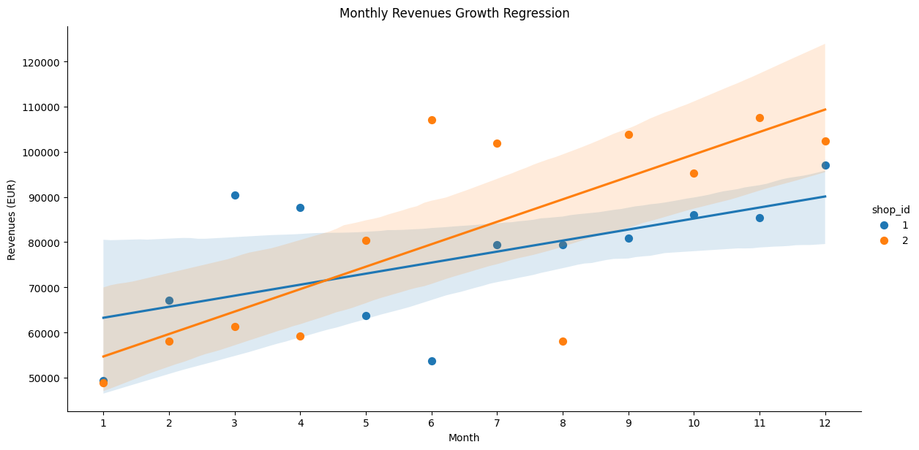
Exploratory Data Analysis (EDA)
Arithmetic linear regression is used to identify growth trends in revenue
We observe continuous positive growth in both shops' monthly revenue
To make an estimate of 2023 monthly revenues of existing shops, regression lines are arithmetically extrapolated to the following 12 months

Slide 5
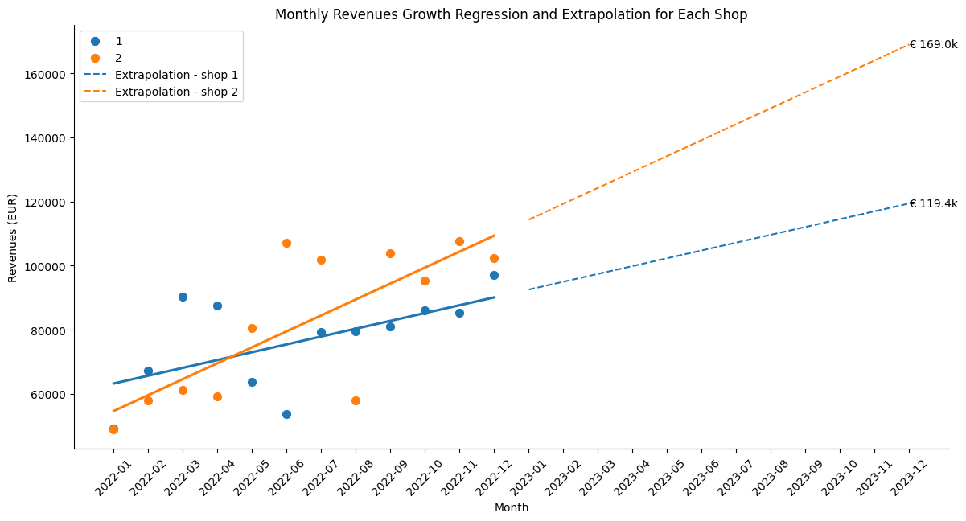
2023 Revenue Forecasting for existing shops (1 and 2)
Extrapolation estimates that monthly revenues of shop 1 and 2 will reach € 119.4k and € 169k respectively in December 2023
The combined estimate of total revenue of shop 1 and 2 across 2023 is € 2,971.7k

Slide 6
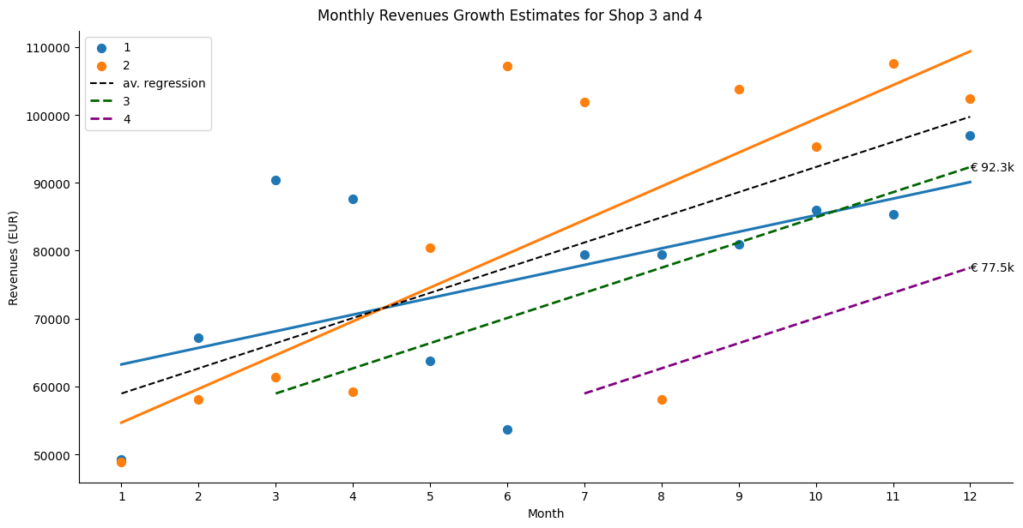
2023 Revenue Forecasting for new shops (3 and 4)
Revenue estimates for the planned shop 3 and 4 are made by averaging the regression lines of shop 1 and 2 in 2022 (the year of shop launching)
The averaged regression line is shifted to the right to start at the month of the planned launching of the respective shop
The combined estimate of total revenue of shop 1 and 2 across 2023 is € 1,165.7k

Slide 7
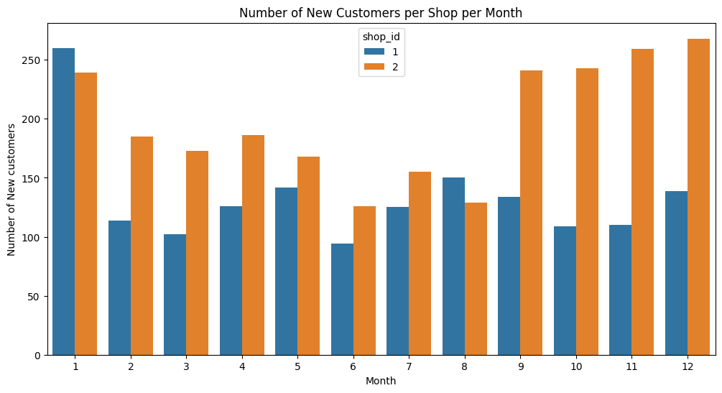
New customers Estimates
We observe that both shops received approximately 250 new customers in the first month
shop 2 exhibits a substantial increase in new customers in Q4 while shop 1 shows a steady number of new customers across the year
An assumption is made that a new shop would also receive an average of 250 new customers in the first month
An assumption is made that the new shop will receive in the consecutive months a number of new customers that is equal to the monthly arithmetic average of shop 1 and 2 from February to December. Regression will also be performed between Feb-Dec

Slide 8
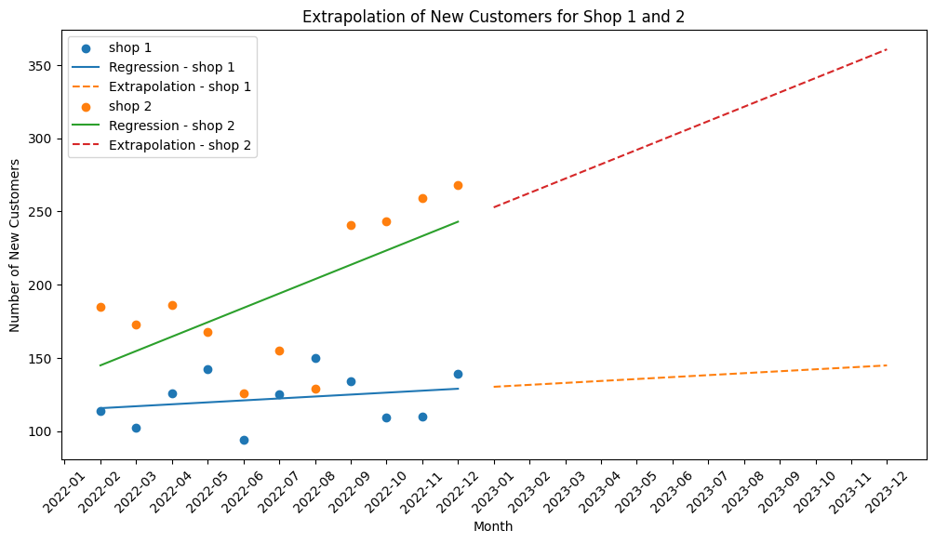
2023 new customers estimates for existing shops
(1 and 2)
EDA showed that shop 1 and 2 received a total of 3,977 new customers in 2022
Extrapolation estimates that shop 1 and 2 combined will receive additional 5,330 new customers in 2023
Estimates for new customers in shop 3 and 4 during 2023 were manually calculated based on the average monthly values of shop 1 and 2
New customers received in shop 3 and 4 during 2023 were estimated at 2,550 customer

Slide 9
Results Summary
€ 4,137.5k
Estimated total revenues from the 4 shops in 2023
€ 2,971.7k
Estimated revenues for existing shops 1 and 2 in 2023
€ 1,165.7k
Estimated revenues for the planned shop 3 and 4 in 2023
7.9k customer
Estimate for new customers signing up in the 4 shops during 2023
5.3k customer
Estimate for new customers signing up in the shop 1 and 2 during 2023
11.9k customer
Estimate for the total customer base of the 4 shops over 2022 and 2023

